Slide 1



Slide 2

AT2 Speaking

Slide 3
What language were you listening to when you came in?
Hands up!

Slide 4


Slide 5

Why do we teach MFL?
What are MFL lessons for?
What do we want or learners to be able to do?
(answers on a post card please)
Notes:
PAUSE get answers from the group

Slide 6
Our ultimate aim
“One of the aims, if not the ultimate aim, of MFL teaching is to enable pupils to conduct conversations in the TL. They need to be well-prepared for this and given the skills and confidence to use the TL in a carefully nurtured atmosphere.”
(Pachler and Field, 2001)
Notes:
Have we answered all the questions?

Slide 7
“confident commnicators” ??

Slide 8
By the end of this session
All will have considered
What is communicative competence?
How we can promote it in the MFL classroom?
Advantages and disadvantages of TL use-the long and the short view
What factors must we overcome to motivate our pupils?
How we can assess the speaking skill effectively?
Some will be motivated to read Dorneyi on Motivation
A few will begin to se Animoto with their pupils

Slide 9

How did you feel when….
you had to speak a foreign language
at school?
at university?
in the target country?
Notes:
Pairs/threes take one example each context

Slide 10

What have you seen in school?
????????

Slide 11
What the inspectors say…
“ Many pupils lack confidence in speaking at length or with fluency, with few showing the ability to use the target language independently.” (Ofsted 2004)
Notes:
Is this your experience in schools? Update on copies given

Slide 12
Enjoyable but…
Most learners feel that being able to communicate orally is an important goal in foreign language learning… but by the end of KS4 it is also the one in which they feel they have had least success…
(Graham 2002)

Slide 13
Progression in speaking skills… what the National Curriculum says
Pupils should:
begin to develop their independence
transfer language across topics
hypothesise and speculate
take risks
think in the language
develop their strategic competence

Slide 14
The challenge…
In successful speaking activities:
Learners talk a lot
Participation is evenly distributed
Motivation is high
Meaningful information is communicated
      (Ur, 1996)
Notes:
Have you seen this

Slide 15

Notes:
YOU CAN’T FORCE A CHILD TO SPEAK

Slide 16

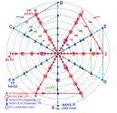
Motivation?
Chambers (2001) uses the analogy of the Heathrow flight plan, which can be consulted in the seat pocket of any airliner to depict the complexity of factors, which may affect motivation.
Notes:
Chambers, G (ed) (2001) Reflections on Motivation CILT

Slide 17
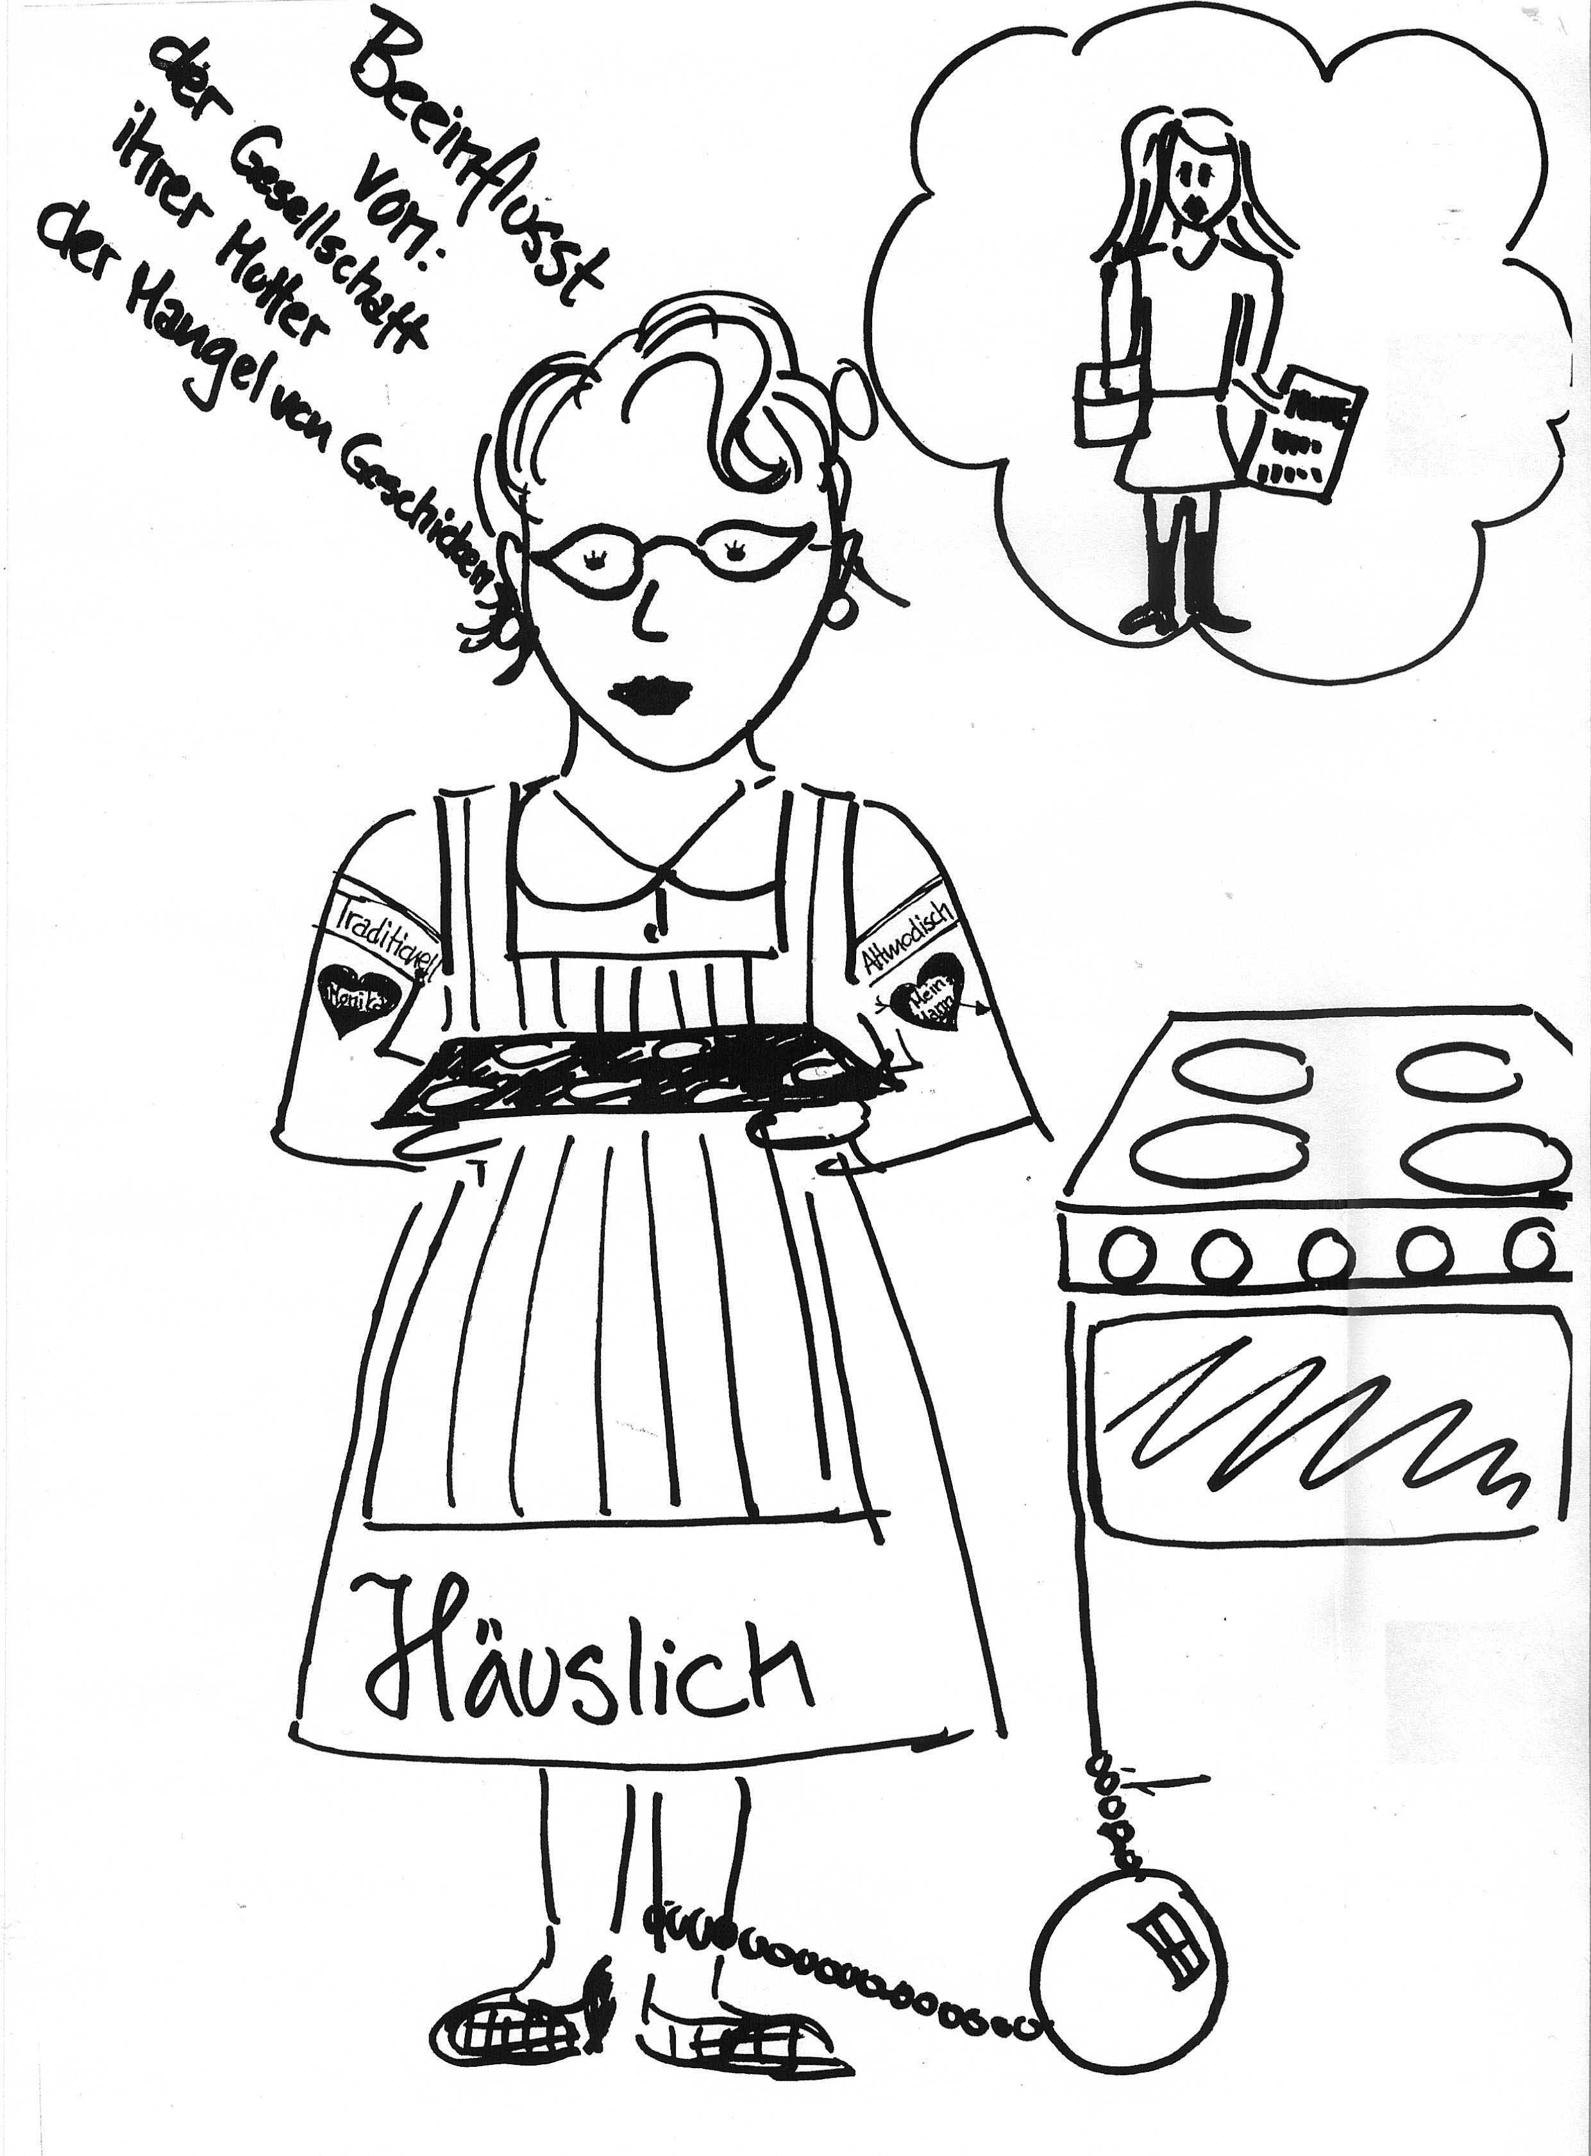
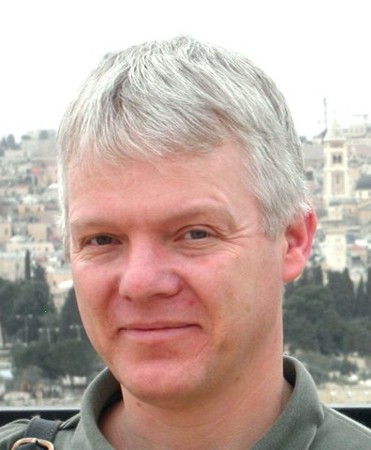

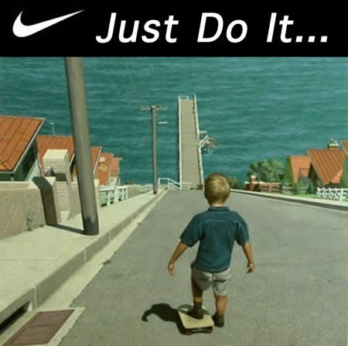
Notes:
Dorneyi can’t do jstice to his theories here bt have picked ot one key idea- the need for learners to have a vision of an ideal self .SELF. PLAUSIBLE GOT TO SEEIT/FEEL IT HEAR IT, SMELL I
If we ask pupils to skate board into the sea we have to motivate them They have to have a desire to be that person who soeaks that other langage. They have to by into that identity

Slide 18
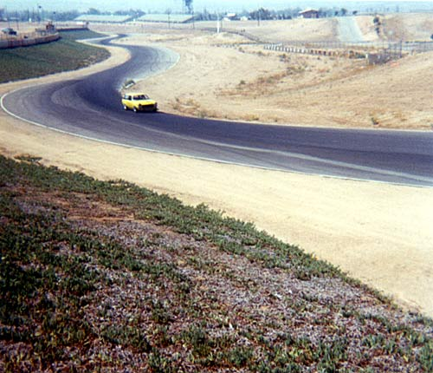

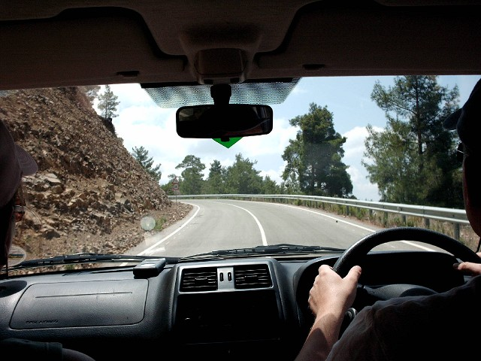

So HOW???
Notes:
Long view and the short view.Difference between reading the manual and driving. Analytic or spontaneous Both are important. What I want is to suggest to you that althogh you will be bound by departmental policy targets/ objectives you shouldn’t loose sight of the LONG VIEW and maybe you don’t get them to CHAT in one lesson if t that’s your aim

Slide 19
What does the NC say about target language use?
“The target language is the modern foreign language the pupils are learning. Pupils are expected to use and respond to the target language, and to use English only when necessary (for example when discussing a grammar point or when comparing English with the target language).”
National Curriculum p16
Notes:
Is this how it is in school?

Slide 20
“sometimes it’s just noise!” (girl 17)
Notes:
My research

Slide 21
Advantages and disadvantages?
Notes:
discuss

Slide 22
Not
With this group they’re not academic
With this group, I’ve got too much to cover
With this activity-it’s too complicated
Today- I’m too tired
With this group because they aren’t used to it!
Notes:
Rationale but not for these reasons!

Slide 23

Vicious and virtuous circles

Slide 24

EAL
Notes:
Already have the experience of other langages or are bilingual. Sing the tL gives them a level playing field

Slide 25

Keeping it simple or the price of carrots?
The French Revolution
The Holocaust
The European Union
Environmental issues
Abortion
Euthanasia
Curriculum content A leve?
(KS3) in other subjects?
Notes:
What do these look like :A level topics
Meaningful topics. Having a reason to communicate

Slide 26
So just what do we mean by “Communicative competence”?
Grammatical competence
Sociolinguistic competence
Strategic competence
Accuracy
Fluency
knowledge of the rules
awareness of audience and purpose
coping strategies
pronunciation, intonation, grammar and register
Keeping going….
Notes:
Elicit what do we mean by all of these?

Slide 27
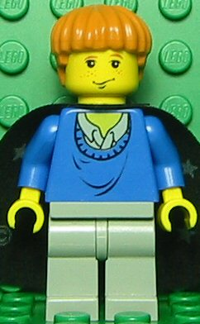
Issues:Communicative competence
In a shop…
“Sweetr
  Blu
  Esmoll pleeze”
  Successful communication?
Notes:
What are we wanting them to do

Slide 28

Pronunciation
How important is it?
How can we teach it?
Should we correct it?
Notes:
Rabat story
List of words
elicit

Slide 29

Suggestions????
Back chaining
Speaking English in the foreign accent
Grouping words by sound not spelling
(find the odd one out)
Starters
Notes:
Ask them……
Think of a long word in your target language and work backwards syllable by syllable

Slide 30

What about strategic competence
How to keep going……
Fillers
Circumlution
Survival techniques:
Slow down
Repeat
How do you say….?
Fluency or the Language of interaction slide 42
Notes:
Alors….ben….
My brother’s a vegetarian or he doesn’t eat meat
Barnes and Graham (1997) claim that candidates at GCSE can’t ask this of the adult conducting the test

Slide 31
Progression in Speaking
Repetition
Structured pair work
Open-ended role-play
Notes:
Let’s look at each one of these in turn

Slide 32
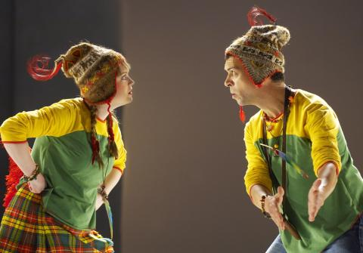
Repetition… Repetition… Repetition…
Use of visual aids
Pantomime competitions
Repeating a word or phrase if it is correct
Guessing
Distributing visual aids
Notes:
Magic Flute?get the language in

Slide 33
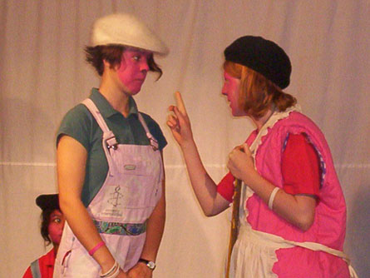
But HOW???
Pair and group work (obvious???)
Uninhibited/Reduced anxiety
Problems?some teachers believe that they
Catch each others mistakes or misbehave
Perhaps they underestimate
Interaction and negotiation of meaning= language acquisition (Lightbrown, 2003)
Notes:
So let’s look at some of the issues…

Slide 34

Structured role play
card games
information gap activities
e.g. complete the timetable
scripting and acting out role plays
e.g. use of speech bubbles in Word to script
Using avatars
http://www.boxoftricks.net/?p=26
Notes:
Practise practise real info gaps

Slide 35
Doing it differently..?
Try a role play (scripted or unscripted) with adverbs as prompts…
Angrily
Romantically
Hesitantly
Hyperactively
Impatiently
In a horror film
Notes:
Get them to buy some bread by row with an adverb of manner

Slide 36
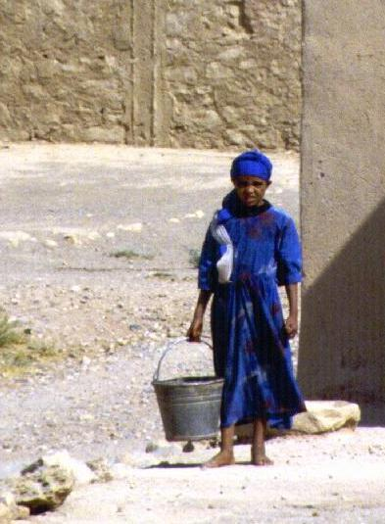
Role play:Daily routine with a difference..
When does she get up?
What does she have for breakfast?
Revisit known language and topics but with a new context and a real information gap!
Notes:
by

Slide 37
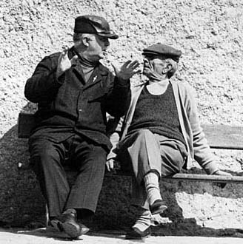
Communication game
Haven’t I seen you somewhere before?
Notes:
Real information gap.. Done with the French grop bt many many simple forms of this where yo have to find people in a family

Slide 38

Open ended activities and doing it differently
Introduce an element of fun and unpredictability
The unhelpful waiter?
Notes:
Anecdote open ended Product design? Exploding the stimulus good role models if we show we need to check things

Slide 39
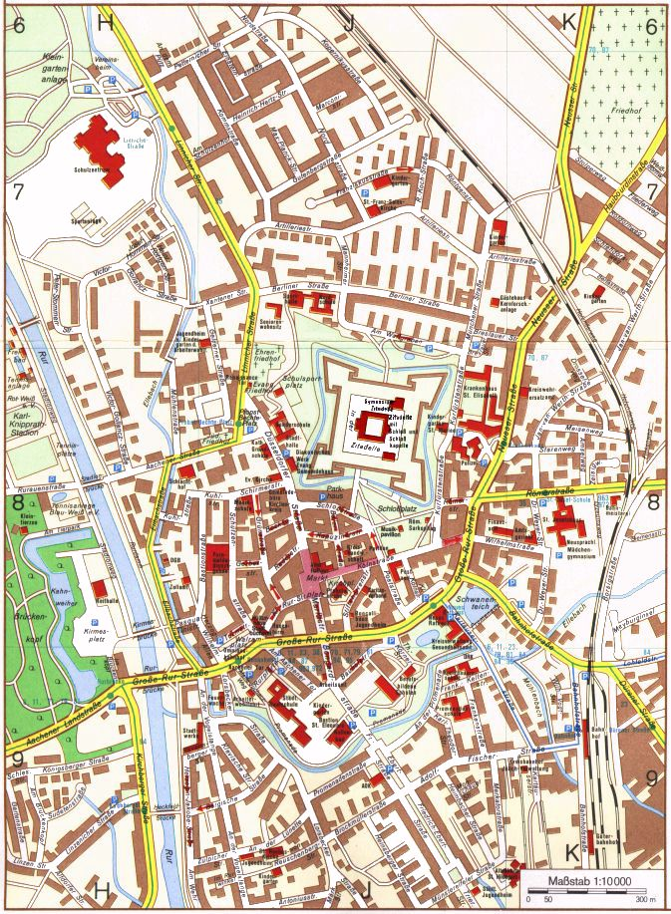
Open ended -Problem solving: where to build a school?

Slide 40
Open ended activities
Whole class activities that allow for open-ended questions
Examples:
Slowly reveal an image
Story

Slide 42
Assessment of Speaking
Why bother?
Pause
audience participation!
Notes:
Why bother - if it isn’t assessed it isn’t important

Slide 43
Assessment of Speaking
ongoing assessment in lessons
peer/ partner observations
clarify exactly what you are looking for and therefore what they need to work on
e.g. pronunciation, use of language, intonation, etc.
video pupils and ask them to ‘critique’ their performance
give credit for comprehension
Homework?
Notes:
Elicit make it clear that you expect feedback.

Slide 44
What if it’s wrong?
What should our strategy be?
To correct or not?
If so, how?
Consider written feedback for speaking work
How can we encourage the disaffected?
Notes:
Ask them
Boys

Slide 45
The place of games to develop the skill of Speaking
Successful language games …
Are based on known games
e.g. Blockbusters, Who wants to be a millionaire
Are not too long
Do not need lengthy explanations
Have clear objectives
Produce a winner

Slide 46
The language of Interaction
negotiating with each other (“Your turn”)
giving instructions (“Repeat”)
giving opinions (“I don’t agree”)
asking questions (“Why?”)
giving an emotional response (“That’s fun”)

Slide 47
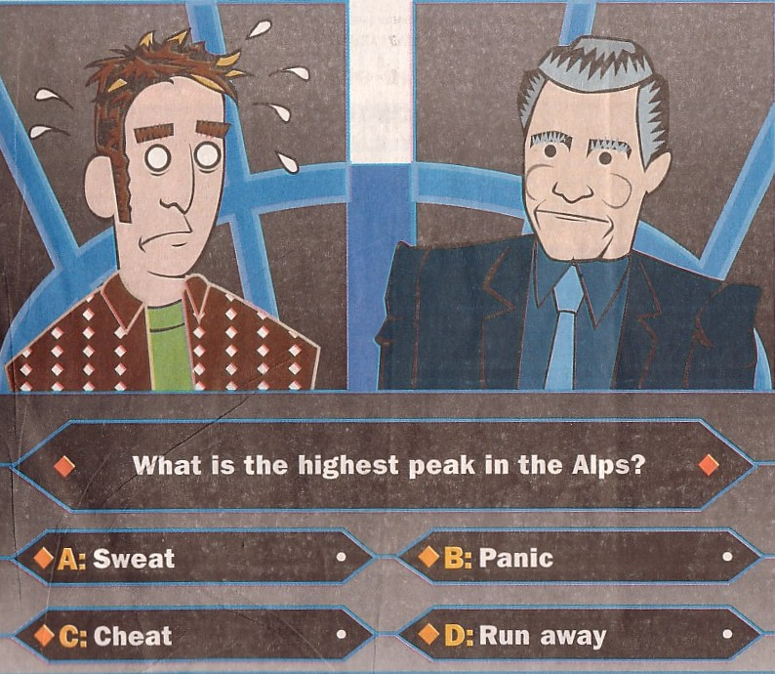
Let’s play!

Slide 48
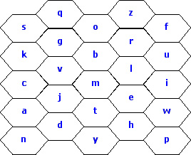

Slide 49
websites
http://www.channel4.com/entertainment/t4/advertorial/try-life-in-another-language/index.html
http://www.bbc.co.uk/languages/spanish/mividaloca/
www.boxoftricks.net
http://www.boxoftricks.net/?p=104

Slide 50

Plan
Think of 2 ideas or strategies that you intend to employ in your next speaking activity or starter or method work.
Write them down!

Slide 52
Bibliography
Chambers, G. (1998) Pupils’ perceptions of the foreign language learning experience Language Teaching research, 2 930:231-59
Chambers, G (ed) (2001) Reflections on Motivation CILT
Chambers, G. (1999) Motivating Language Learners. Clevedon:Multi-lingual Matters Ltd
Graham, S.(2002) Effective Language Learning Clevedon: Multi-lingual Matters Ltd

Slide 53
Bibliography
Lightbrown, P. (2003) SLA research in the Classroom/SLA Research for the classroom Language Learning Journal 28;4-13
Ofsted (2004) OFSTED Subject Reports 2002-2003 Modern Foreign Languages in secondary schools London:HMI Available at www.ofsted.gov.uk
Ur, P.(1996) A Course in Language Teaching: Practice and Theory Cambridge: Cambridge University Press
Ur, P.(1984) Discussions that Work Cambridge: Cambridge

